Slide 1
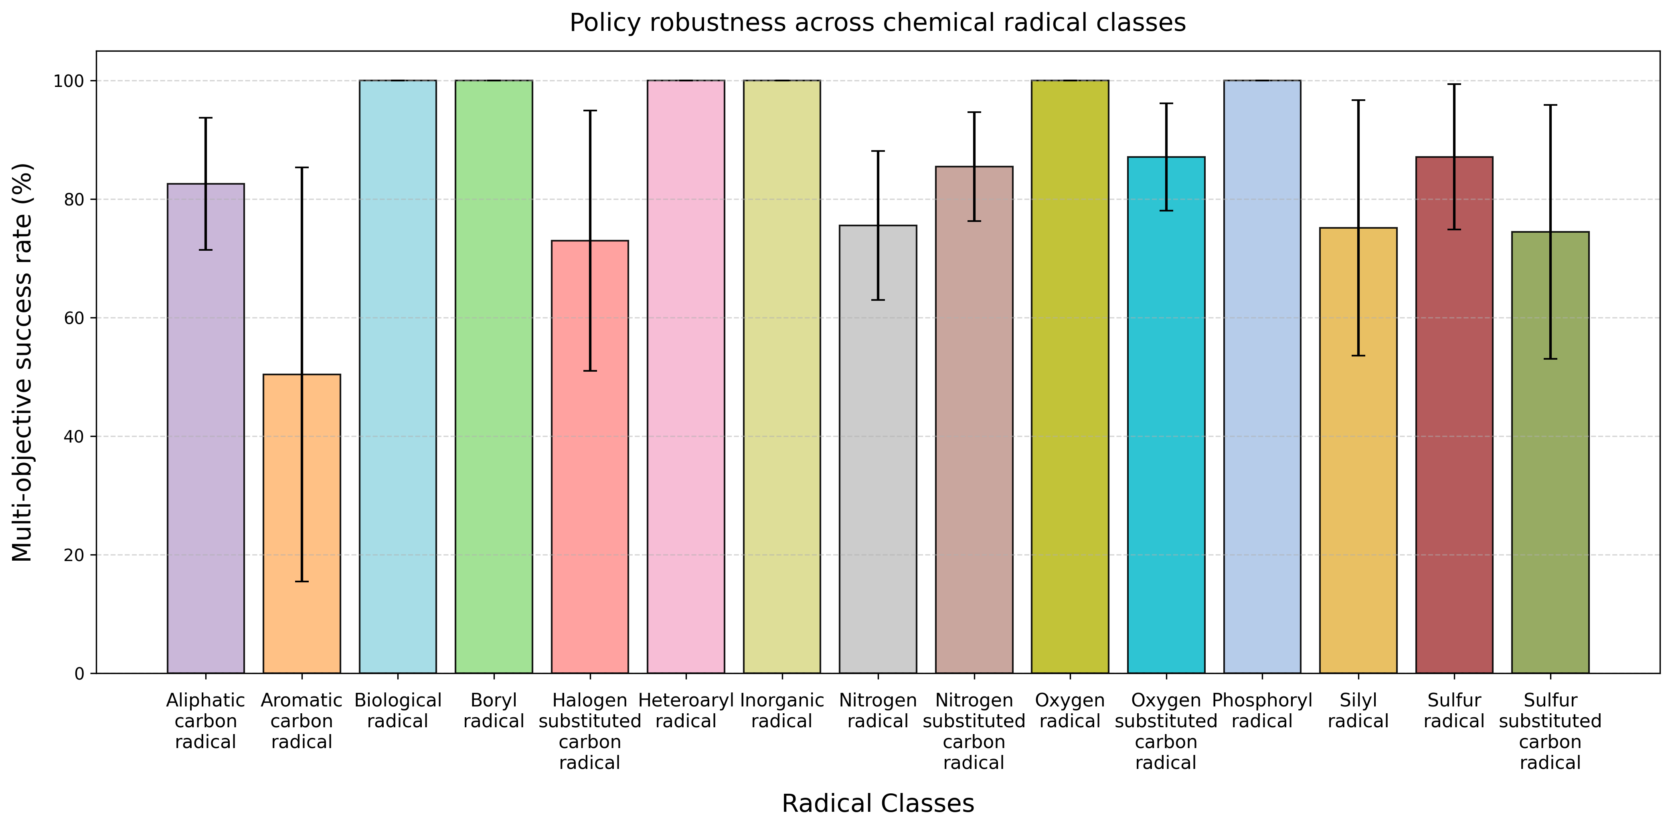
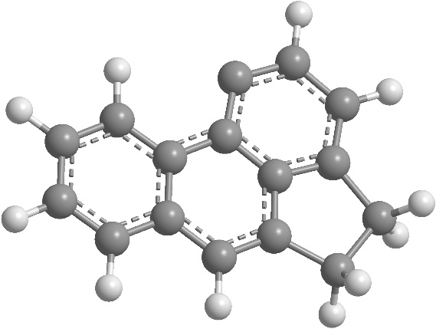
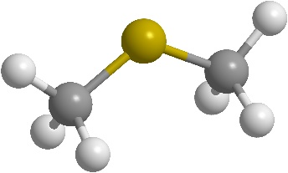
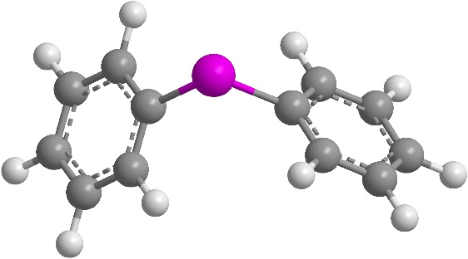
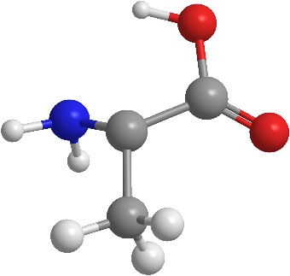
A.
B.
1-amino-1-carboxyethyl
[Biological radical]
Dimethylboranyl
[Boryl radical]
Diphenylphosphanyl
[Phosphoryl radical]
Acephenanthrenyl
[Aromatic carbon radical]

Slide 2
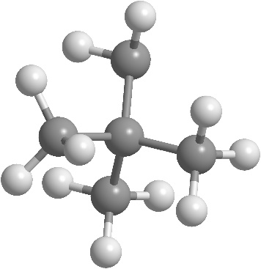
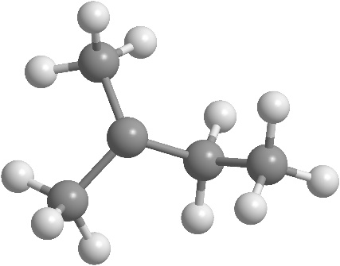
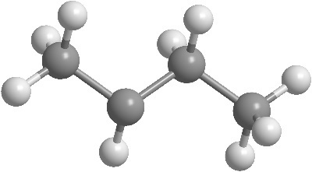
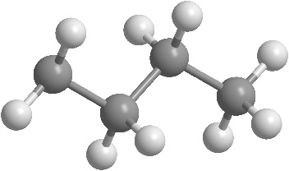
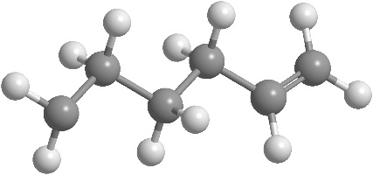
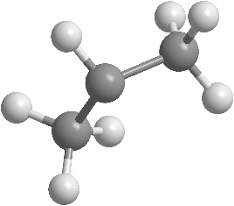
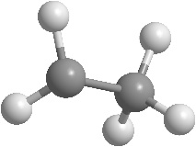
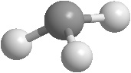
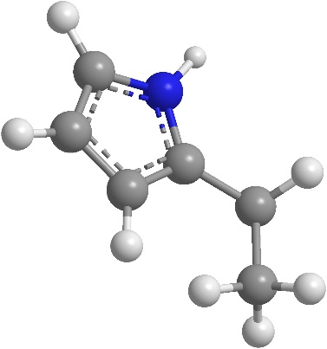
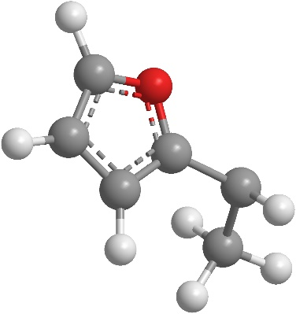
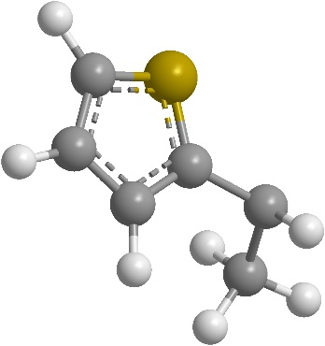
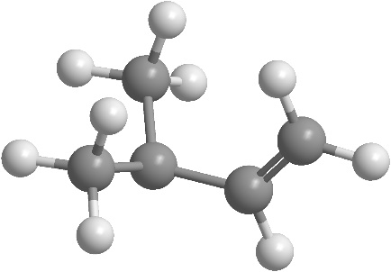
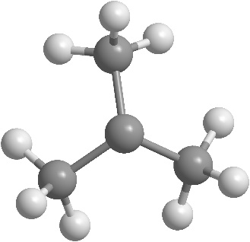
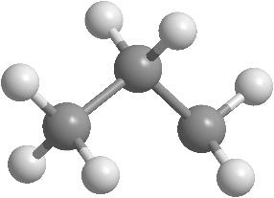
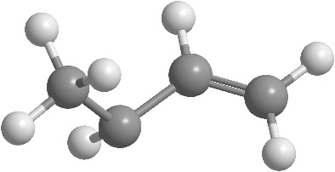
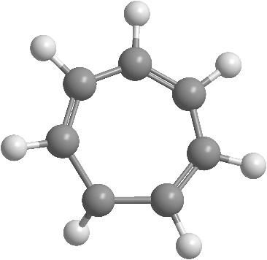
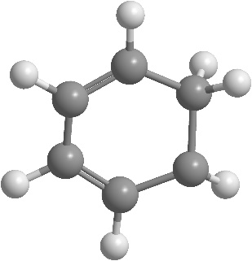
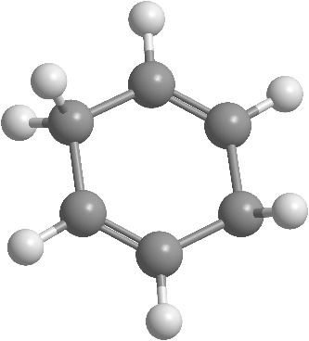
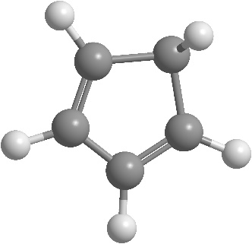
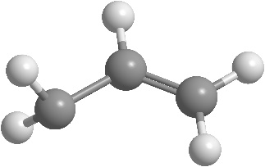
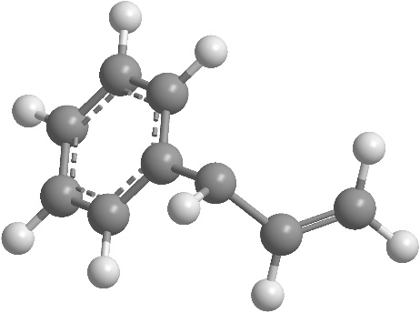
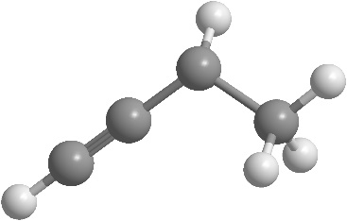
22dimethyl_propyl
[Aliphatic carbon radical]
2methyl_butan_2yl
[Aliphatic carbon radical]
butan_2yl
[Aliphatic carbon radical]
Butyl
[Aliphatic carbon radical]
Ethyl
[Aliphatic carbon radical]
hex_5en_1yl
[Aliphatic carbon radical]
propan_2yl
[Aliphatic carbon radical]
Methyl
[Aliphatic carbon radical]
Propyl
[Aliphatic carbon radical]
Tert butyl
[Aliphatic carbon radical]
1-_1H-pyrrol-2-yl_ethyl
[Aliphatic carbon radical]
1-_furan_2yl_ethyl
[Aliphatic carbon radical]
1-_thiophene_2yl_ethyl
[Aliphatic carbon radical]
2-methylbut-3-en-2yl
[Aliphatic carbon radical]
but-3-en-2-yl
[Aliphatic carbon radical]
but-3-yn-2-yl
[Aliphatic carbon radical]
cyclohepta-246-trien-1-yl
[Aliphatic carbon radical]
cyclohexa-24-dien-1-yl
[Aliphatic carbon radical]
cyclopenta-24-dien-1-yl
[Aliphatic carbon radical]
1-phenylprop-2-en-1-yl
[Aliphatic carbon radical]
cyclohexa-25-dien-1-yl
[Aliphatic carbon radical]
prop-2-en-1-yl
[Aliphatic carbon radical]

Slide 3
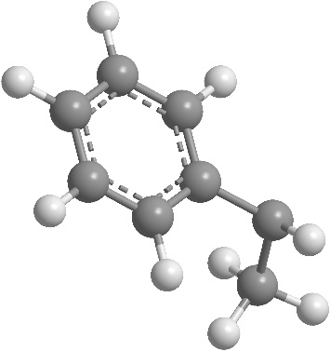
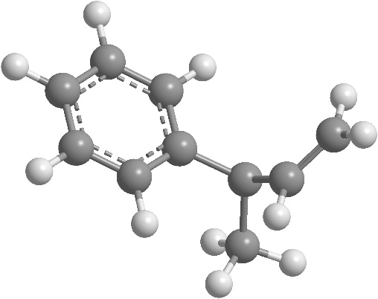
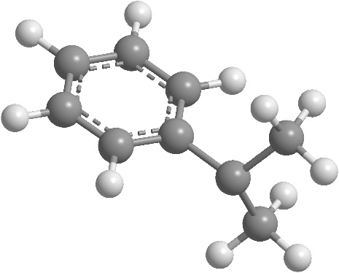
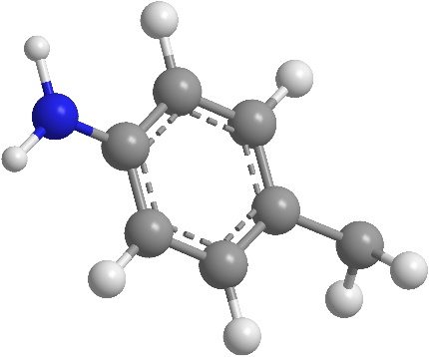
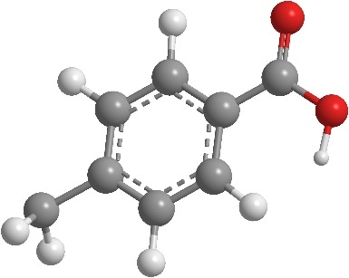
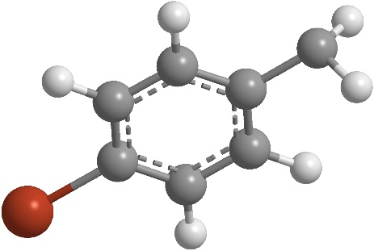
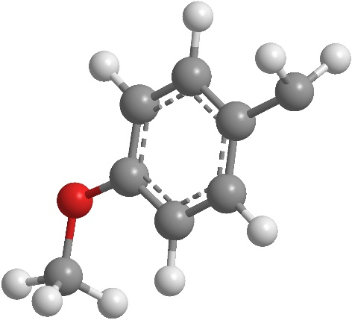
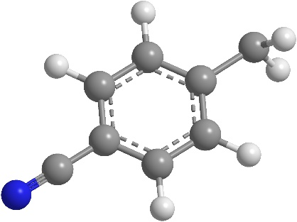
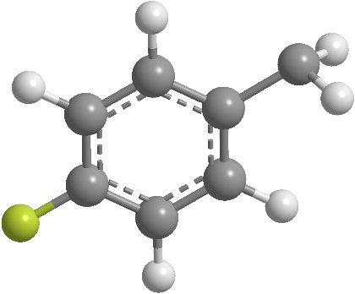
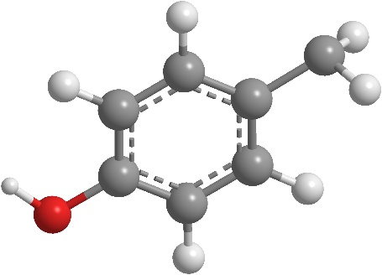
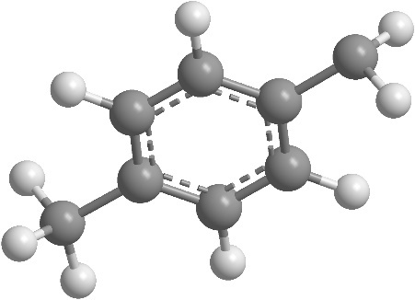
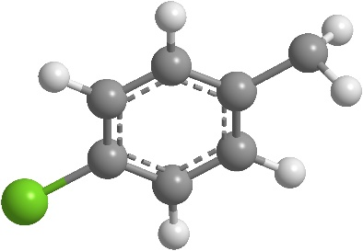
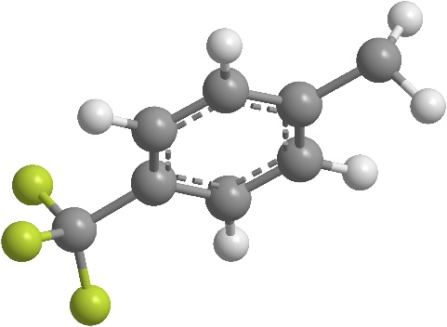
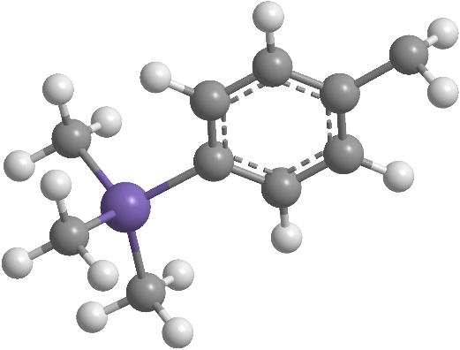
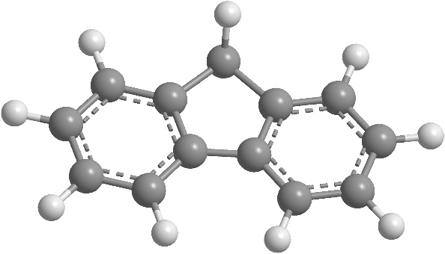
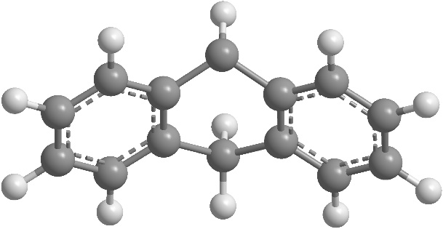
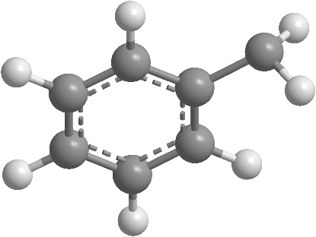
1phenylethyl
[Aliphatic carbon radical]
2-phenylbut-3-en-2-yl
[Aliphatic carbon radical]
2-phenylpropan-2-yl
[Aliphatic carbon radical]
4-aminophenyl_methyl
[Aliphatic carbon radical]
4-bromophenyl_methyl
[Aliphatic carbon radical]
4-carboxyphenyl_methyl
[Aliphatic carbon radical]
4-chlorophenyl_methyl
[Aliphatic carbon radical]
4-cyanophenyl_methyl
[Aliphatic carbon radical]
4-fluorophenyl_methyl
[Aliphatic carbon radical]
4-hydroxyphenyl_methyl
[Aliphatic carbon radical]
4-methoxyphenyl_methyl
[Aliphatic carbon radical]
4-methylphenyl_methyl
[Aliphatic carbon radical]
4-trifluoromethyl_phenyl_methyl
[Aliphatic carbon radical]
4-trimethylsilyl_phenyl_methyl
[Aliphatic carbon radical]
9H_fluoren_9yl
[Aliphatic carbon radical]
9_10_dihydroanthracene_9yl
[Aliphatic carbon radical]
Benzyl
[Aliphatic carbon radical]

Slide 4
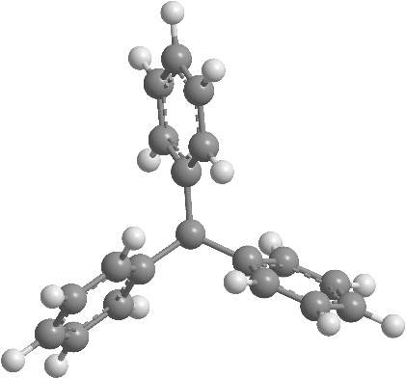
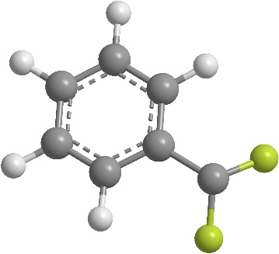
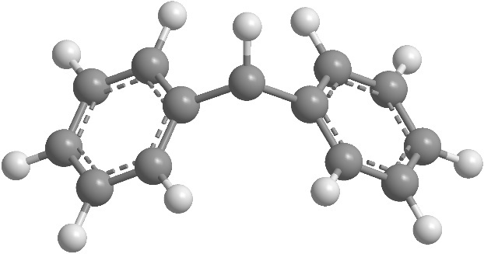
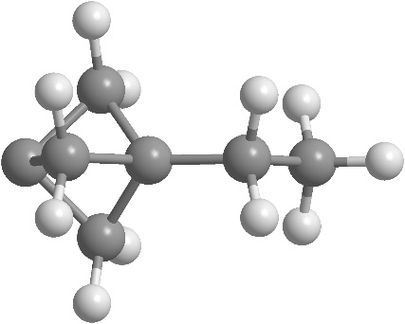
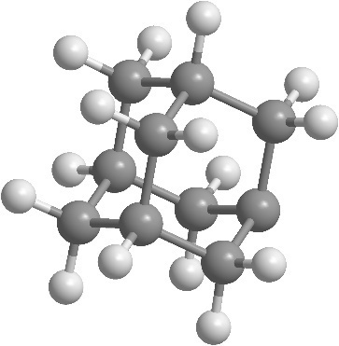
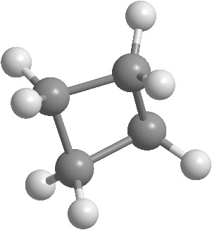












difluoro_phenyl_methyl
[Aliphatic carbon radical]
Diphenylmethyl
[Aliphatic carbon radical]
Triphenylmethyl
[Aliphatic carbon radical]
3-ethylbicyclo_111_pentan-1-yl
[Aliphatic carbon radical]
adamantan_1yl
[Aliphatic carbon radical]
Cyclobutyl
[Aliphatic carbon radical]
Ethenyl
[Aliphatic carbon radical]
Ethynyl
[Aliphatic carbon radical]
prop_1en_2yl
[Aliphatic carbon radical]
Cyclohexyl
[Aliphatic carbon radical]
Cyclopentyl
[Aliphatic carbon radical]
Cyclopropyl
[Aliphatic carbon radical]
prop_1en_1yl
[Aliphatic carbon radical]
1-amino-1-carboxyethyl
[Biological radical]
1-carboxy-1-acetamidoethyl
[Biological radical]
2S_-2-amino-2-carboxyethyl_oxidanyl
[Biological radical]
2R_-2-amino-2-carboxyethyl_sulfanyl
[Biological radical]
2R_3S_4R_5R_-34-dihydroxy-5-_hydroxymethyl_oxolan-2-yl_aminyl
[Biological radical]
adenosine_radical
[Biological radical]

Slide 5


















guanosine_radical
[Biological radical]
Pyranose
[Biological radical]
13dimethyl1Himidazol_3ium_2yl_boranuidyl
[Boryl radical]
2H_132dioxaborol_2yl
[Boryl radical]
4dimethylamino_pyridin1ium_1yl_boranuidyl
[Boryl radical]
Boranyl
[Boryl radical]
Dihydroxyboranyl
[Boryl radical]
Dimethylboranyl
[Boryl radical]
Diphenylboranyl
[Boryl radical]
tetramethyl-1,3,2-dioxaborolan-2-yl
[Boryl radical]
trimethoxyphosphaniumyl_boranuidyl
[Boryl radical]
trimethylazaniumyl_boranuidyl
[Boryl radical]
1,3-dimethyl-2-oxo-1,3,2-diazaphospholidin-2-yl
[Phosphoryl radical]
bis_dimethylamino_phosphanyl
[Phosphoryl radical]
Diethoxyphosphoroso
[Phosphoryl radical]
Dimethoxyphosphanyl
[Phosphoryl radical]
dimethylphosphanyl
[Phosphoryl radical]
dimethylphosphoroso
[Phosphoryl radical]
Diphenoxyphosphoroso
[Phosphoryl radical]

Slide 6

















Diphenylphosphanyl
[Phosphoryl radical]
Diphenylphosphoroso
[Phosphoryl radical]
111333hexamethyl_2trimethylsilyl_oxy_trisilan_2yl
[Silyl radical]
111333hexamethyl_2trimethylsilyl_trisilan_2yl
[Silyl radical]
diethoxy_methyl_silyl
[Silyl radical]
Ethoxydimethylsilyl
[Silyl radical]
Triethoxysilyl
[Silyl radical]
tris_propan_2yl_silyl
[Silyl radical]
1H_pyrazol_3yl
[Heteroaryl radical]
Trimethylsilyl
[Silyl radical]
Triphenylsilyl
[Silyl radical]
1H_pyrrol_2yl
[Heteroaryl radical]
1H_pyrrol_3yl
[Heteroaryl radical]
pyrazin_2yl
[Heteroaryl radical]
pyridin_2yl
[Heteroaryl radical]
pyridin_3yl
[Heteroaryl radical]
pyridin_4yl
[Heteroaryl radical]
pyrimidin_2yl
[Heteroaryl radical]

Slide 7















pyrimidin_4yl
[Heteroaryl radical]
246trimethoxyphenyl
[Heteroaryl radical]
246trimethylphenyl
[Heteroaryl radical]
24dimethoxyphenyl
[Heteroaryl radical]
35difluorophenyl
[Heteroaryl radical]
furan_3yl
[Heteroaryl radical]
5methyl_2methylsulfamoyl_phenyl
[Heteroaryl radical]
Pentafluorophenyl
[Heteroaryl radical]
1,3oxazol_2yl
[Heteroaryl radical]
furan_2yl
[Heteroaryl radical]
thiophene_2yl
[Heteroaryl radical]
thiophene_3yl
[Heteroaryl radical]
1diethylboranyl_ethyl
[Boron substituted carbon radical]
1_1,3,2dioxaborolan_2yl_ethyl
[Boron substituted carbon radical]
1dimethyl_methylamino_silyl_ethyl
[Silicon substituted carbon radical]

Slide 8


















1trimethylsilyl_ethyl
[Silicon substituted carbon radical]
dimethyl_phenyl_silyl_methyl
[Silicon substituted carbon radical]
methoxydimethylsilyl_methyl
[Silicon substituted carbon radical]
13dithian_2yl
[Sulfur substituted carbon radical]
1methylsulfanyl_ethyl
[Sulfur substituted carbon radical]
trimethylsilyl_methyl
[Silicon substituted carbon radical]
Sulfanylmethyl
[Sulfur substituted carbon radical]
thian_2yl
[Sulfur substituted carbon radical]
1benzenesulfonyl_ethyl
[Sulfur substituted carbon radical]
1ethanesulfonyl_ethyl
[Sulfur substituted carbon radical]
1phenylsulfanyl_ethyl
[Sulfur substituted carbon radical]
methylsulfanyl_methyl
[Sulfur substituted carbon radical]
1methoxysulfonyl_ethyl
[Sulfur substituted carbon radical]
1methylsulfamoyl_ethyl
[Sulfur substituted carbon radical]
1phenylsulfamoyl_ethyl
[Sulfur substituted carbon radical]
1aminosulfinyl_ethyl
[Sulfur substituted carbon radical]
1benzenesulfinyl_ethyl
[Sulfur substituted carbon radical]
benzenesulfonyl_methyl
[Sulfur substituted carbon radical]

Slide 9























1ethanesulfinyl_ethyl
[Sulfur substituted carbon radical]
Methanesulfinylmethyl
[Sulfur substituted carbon radical]
2sulfanylethyl
[Sulfur substituted carbon radical]
3sulfanylpropyl
[Sulfur substituted carbon radical]
11333pentachloro_2oxopropyl
[Halogen substituted carbon radical]
11dichloro_2oxobutyl
[Halogen substituted carbon radical]
12dichloroethyl
[Halogen substituted carbon radical]
12difluoroethyl
[Halogen substituted carbon radical]
222trichloroethyl
[Halogen substituted carbon radical]
222trifluoroethyl
[Halogen substituted carbon radical]
2chloroethyl
[Halogen substituted carbon radical]
2ethoxy_11difluoro_2oxoethyl
[Halogen substituted carbon radical]
2ethoxy_1fluoro_2oxoethyl
[Halogen substituted carbon radical]
2fluoroethyl
[Halogen substituted carbon radical]
333trifluoropropyl
[Halogen substituted carbon radical]
3chloropropyl
[Halogen substituted carbon radical]
3fluoropropyl
[Halogen substituted carbon radical]
Bromomethyl
[Halogen substituted carbon radical]
Chloromethyl
[Halogen substituted carbon radical]
Dichloromethyl
[Halogen substituted carbon radical]
dichloro_cyano_methyl
[Halogen substituted carbon radical]
Difluoromethyl
[Halogen substituted carbon radical]
Cyanodifluoromethyl
[Halogen substituted carbon radical]

Slide 10


















Nonafluorobutyl
[Halogen substituted carbon radical]
trichloromethyl
[Halogen substituted carbon radical]
Trifluoromethyl
[Halogen substituted carbon radical]
Azido
[Inorganic radical]
Bromanyl
[Inorganic radical]
Fluoromethyl
[Halogen substituted carbon radical]
Chloranyl
[Inorganic radical]
Fluoranyl
[Inorganic radical]
2oxopyrrolidin_1yl
[Nitrogen radical]
methoxycarbonyl_222trifluoroethyl_aminyl
[Nitrogen radical]
methoxycarbonyl_methyl_aminyl
[Nitrogen radical]
Cyano
[Inorganic radical]
N_methylacetamidyl
[Nitrogen radical]
N_methylformamidyl
[Nitrogen radical]
tert_butoxy_carbonyl_methyl_aminyl
[Nitrogen radical]
2266tetramethylpiperidin_1yl
[Nitrogen radical]
Azanyl
[Nitrogen radical]
bis_trimethylsilyl_aminyl
[Nitrogen radical]

Slide 11



















cyano_methyl_aminyl
[Nitrogen radical]
diethoxyphosphoryl_methyl_aminyl
[Nitrogen radical]
Difluoroaminyl
[Nitrogen radical]
Dimethylaminyl
[Nitrogen radical]
Diphenylaminyl
[Nitrogen radical]
diphenylphosphoroso_methyl_aminyl
[Nitrogen radical]
Methylaminyl
[Nitrogen radical]
methyl_nitro_aminyl
[Nitrogen radical]
methyl_phenyl_aminyl
[Nitrogen radical]
piperidin_1yl
[Nitrogen radical]
trimethylsilyl_aminyl
[Nitrogen radical]
Pentylaminyl
[Nitrogen radical]
Phenylaminyl
[Nitrogen radical]
13dioxo_23dihydro_1Hisoindol_2yl_aminyl
[Nitrogen radical]
trimethylhydrazin_1yl
[Nitrogen radical]
methanesulfonyloxy_methyl_aminyl
[Nitrogen radical]
Methoxyaminyl
[Nitrogen radical]
Hydrazinyl
[Nitrogen radical]
Hydroxyaminyl
[Nitrogen radical]

Slide 12


















methoxy_methyl_aminyl
[Nitrogen radical]
methoxy_phenyl_aminyl
[Nitrogen radical]
trimethylsilyl_oxy_aminyl
[Nitrogen radical]
13dioxo_23dihydro_1Hisoindol_2yl
[Nitrogen radical]
25dioxopyrrolidin_1yl
[Nitrogen radical]
25dioxo_25dihydro_1Hpyrrol_1yl
[Nitrogen radical]
35dichloro_246trioxo_135triazinan_1yl
[Nitrogen radical]
44dimethyl_25dioxoimidazolidin_1yl
[Nitrogen radical]
111trichloropropan_2ylidene_aminyl
[Nitrogen radical]
1phenylethylidene_aminyl
[Nitrogen radical]
222trichloro_1methoxyethylidene_aminyl
[Nitrogen radical]
1methoxyethylidene_aminyl
[Nitrogen radical]
bis_methoxycarbonyl_amino_methylidene_aminyl
[Nitrogen radical]
diaminomethylidene_aminyl
[Nitrogen radical]
dimethoxymethylidene_aminyl
[Nitrogen radical]
diphenylmethylidene_aminyl
[Nitrogen radical]
methoxy_phenyl_methylidene_aminyl
[Nitrogen radical]
methylamino_phenyl_methylidene_aminyl
[Nitrogen radical]

Slide 13















propan_2ylidene_aminyl
[Nitrogen radical]
methoxysulfonyl_methyl_aminyl
[Nitrogen radical]
Nmethyltrifluoromethanesulfonamido
[Nitrogen radical]
Nmethyl_4methylbenzenesulfonamido
[Nitrogen radical]
methylsulfanyl_phenyl_methylidene_aminyl
[Nitrogen radical]
Isocyanato
[Nitrogen radical]
Nmethyl_4nitrobenzenesulfonamido
[Nitrogen radical]
Npentyl_4methylbenzenesulfonamido
[Nitrogen radical]
Nphenyl_4methylbenzenesulfonamido
[Nitrogen radical]
Ntrifluoromethanesulfonyltrifluoromethanesulfonamido
[Nitrogen radical]
N_benzenesulfonyl_benzenesulfonamido
[Nitrogen radical]
N_methylmethanesulfonamido
[Nitrogen radical]
N_phenylmethanesulfonamido
[Nitrogen radical]
1acetylpyrrolidin_2yl
[Nitrogen substituted carbon radical]
1N_methylacetamido_ethyl
[Nitrogen substituted carbon radical]

Slide 14



















1tert-butoxy_carbonyl_pyrrolidin_2yl
[Nitrogen substituted carbon radical]
222trifluoroacetamido_methyl
[Nitrogen substituted carbon radical]
4acetylmorpholin_3yl
[Nitrogen substituted carbon radical]
4tertbutoxy_carbonyl_morpholin_3yl
[Nitrogen substituted carbon radical]
1N_phenylacetamido_ethyl
[Nitrogen substituted carbon radical]
2oxopyrrolidin_1yl_methyl
[Nitrogen substituted carbon radical]
Acetamidomethyl
[Nitrogen substituted carbon radical]
methoxycarbonyl_amino_methyl
[Nitrogen substituted carbon radical]
Nmethylacetamido_methyl
[Nitrogen substituted carbon radical]
13oxazolidin_2yl
[Nitrogen substituted carbon radical]
1aminoethyl
[Nitrogen substituted carbon radical]
1bis_propan_2yl_amino_ethyl
[Nitrogen substituted carbon radical]
1diethylamino_ethyl
[Nitrogen substituted carbon radical]
1diphenylamino_ethyl
[Nitrogen substituted carbon radical]
1methylpyrrolidin_2yl
[Nitrogen substituted carbon radical]
1methyl_phenyl_amino_ethyl
[Nitrogen substituted carbon radical]
1methylamino_ethyl
[Nitrogen substituted carbon radical]
1methylpiperidin_2yl
[Nitrogen substituted carbon radical]
1phenylamino_ethyl
[Nitrogen substituted carbon radical]

Slide 15


















1phenylpyrrolidin_2yl
[Nitrogen substituted carbon radical]
4methylmorpholin_3yl
[Nitrogen substituted carbon radical]
Aminomethyl
[Nitrogen substituted carbon radical]
imidazolidin_2yl
[Nitrogen substituted carbon radical]
morpholin_3yl
[Nitrogen substituted carbon radical]
4phenylmorpholin_3yl
[Nitrogen substituted carbon radical]
Cyanomethyl
[Nitrogen substituted carbon radical]
Dicyanomethyl
[Nitrogen substituted carbon radical]
piperidin_2yl
[Nitrogen substituted carbon radical]
pyrrolidin_2yl
[Nitrogen substituted carbon radical]
1cyanoethyl
[Nitrogen substituted carbon radical]
1cyano_1methylethyl
[Nitrogen substituted carbon radical]
dicyano_phenyl_methyl
[Nitrogen substituted carbon radical]
Tricyanomethyl
[Nitrogen substituted carbon radical]
14methylbenzenesulfonamido_pentyl
[Nitrogen substituted carbon radical]
14methylbenzenesulfonyl_piperidin_2yl
[Nitrogen substituted carbon radical]
13_dioxo_23dihydro_1Hisoindol_2yl_methyl
[Nitrogen substituted carbon radical]
25dioxopyrrolidin_1yl_methyl
[Nitrogen substituted carbon radical]

Slide 16


















1trifluoromethanesulfonylpyrrolidin_2yl
[Nitrogen substituted carbon radical]
4methylbenzenesulfonamido_methyl
[Nitrogen substituted carbon radical]
1methylpiperidin_4yl
[Nitrogen substituted carbon radical]
trifluoromethanesulfonamido_methyl
[Nitrogen substituted carbon radical]
1methylpiperidin_3yl
[Nitrogen substituted carbon radical]
14methylbenzenesulfonyl_pyrrolidin_2yl
[Nitrogen substituted carbon radical]
3dimethylamino_bicyclo_111_pentan_1yl
[Nitrogen substituted carbon radical]
2aminoethyl
[Nitrogen substituted carbon radical]
3aminopropyl
[Nitrogen substituted carbon radical]
1tert_butoxy_carbonyl_pyrrolidin_3yl
[Nitrogen substituted carbon radical]
1tert_butoxy_carbonyl_piperidin_4yl
[Nitrogen substituted carbon radical]
1tert_butoxy_carbonyl_azetidin_3yl
[Nitrogen substituted carbon radical]
14methylbenzenesulfonamido_pentan_2yl
[Nitrogen substituted carbon radical]
14methylbenzenesulfonamido_pentan_3yl
[Nitrogen substituted carbon radical]
5_4methylbenzenesulfonamido_pentan_2yl
[Nitrogen substituted carbon radical]
piperidin_3yl
[Nitrogen substituted carbon radical]
piperidin_4yl
[Nitrogen substituted carbon radical]
pyrrolidin_3yl
[Nitrogen substituted carbon radical]

Slide 17




















4methoxybenzoyloxidanyl
[Oxygen Radical]
222trifluoroacetyl_oxidanyl
[Oxygen Radical]
22dimethylpropanoyl_oxidanyl
[Oxygen Radical]
4dimethylamino_benzoyloxidanyl
[Oxygen Radical]
4methylbenzoyloxidanyl
[Oxygen Radical]
4trifluoromethyl_benzoyloxidanyl
[Oxygen Radical]
Acetyloxidanyl
[Oxygen Radical]
Formyloxidanyl
[Oxygen Radical]
diphenylmethyl_oxidanyl
[Oxygen Radical]
Ethyloxidanyl
[Oxygen Radical]
hexan_2yloxidanyl
[Oxygen Radical]
111333hexafluoropropan_2yl_oxidanyl
[Oxygen Radical]
222trifluoroethyl_oxidanyl
[Oxygen Radical]
Methyloxidanyl
[Oxygen Radical]
Propyloxidanyl
[Oxygen Radical]
tert_butyloxidanyl
[Oxygen Radical]
13dioxo_23dihydro_1Hisoindol_2yl_oxidanyl
[Oxygen Radical]
2266tetramethylpiperidin_1yl_oxidanyl
[Oxygen Radical]
Acetamidooxidanyl
[Oxygen Radical]
Hydroxyl
[Oxygen Radical]

Slide 18



















dimethylamino_oxidanyl
[Oxygen Radical]
E_1_phenylethylidene_amino_oxidanyl
[Oxygen Radical]
Benzylperoxy
[Oxygen Radical]
Acetylperoxy
[Oxygen Radical]
Ethylperoxy
[Oxygen Radical]
Hydroperoxyl
[Oxygen Radical]
Aminooxidanyl
[Oxygen Radical]
246trinitrophenyl_oxidanyl
[Oxygen Radical]
propan_2ylperoxy
[Oxygen Radical]
24dinitrophenyl_oxidanyl
[Oxygen Radical]
26di_tert_butyl_4methylphenyl_oxidanyl
[Oxygen Radical]
35bis_trifluoromethyl_phenyl_oxidanyl
[Oxygen Radical]
3nitrophenyl_oxidanyl
[Oxygen Radical]
4hydroxy_236trimethylphenyl_oxidanyl
[Oxygen Radical]
4methoxyphenyl_oxidanyl
[Oxygen Radical]
4tert_butylphenyl_oxidanyl
[Oxygen Radical]
4trifluoromethyl_phenyl_oxidanyl
[Oxygen Radical]
3trifluoromethyl_phenyl_oxidanyl
[Oxygen Radical]
4nitrophenyl_oxidanyl
[Oxygen Radical]

Slide 19

















Phenyloxidanyl
[Oxygen Radical]
dimethoxyphosphoryl_oxidanyl
[Oxygen Radical]
methoxydimethylsilyl_oxidanyl
[Oxygen Radical]
trimethylsilyl_oxidanyl
[Oxygen Radical]
benzenesulfinyl_oxidanyl
[Oxygen Radical]
4methylbenzenesulfonyl_oxidanyl
[Oxygen Radical]
Benzoyl
[Oxygen substituted carbon radical]
Formyl
[Oxygen substituted carbon radical] l
Methanesulfonyloxidanyl
[Oxygen Radical]
methoxysulfonyl_oxidanyl
[Oxygen Radical]
Trifluoromethanesulfonyloxidanyl
[Oxygen Radical]
Acetyl
[Oxygen substituted carbon radical]
methoxy_carbonyl
[Oxygen substituted carbon radical]
NNdimethyl_carbamoyl
[Oxygen substituted carbon radical]
14_dimethoxy_14_dioxobutan_2yl
[Oxygen substituted carbon radical]
1ethoxy_1oxopropan_2yl
[Oxygen substituted carbon radical]
1ethoxy_2methyl_1oxopropan_2yl
[Oxygen substituted carbon radical]

Slide 20















2ethoxy_2oxoethyl
[Oxygen substituted carbon radical]
2oxocyclohexyl
[Oxygen substituted carbon radical]
2oxocyclopentyl
[Oxygen substituted carbon radical]
2oxopropyl
[Oxygen substituted carbon radical]
2oxo_2phenylethyl
[Oxygen substituted carbon radical]
2tertbutoxy_2oxoethyl
[Oxygen substituted carbon radical]
3oxo_butan_2yl
[Oxygen substituted carbon radical]
4acetyloxy_1methoxy_1oxopentan_2yl
[Oxygen substituted carbon radical]
dimethylcarbamoyl_methyl
[Oxygen substituted carbon radical]
111333hexafluoro_2hydroxypropan_2yl
[Oxygen substituted carbon radical]
13dioxolan_2yl
[Oxygen substituted carbon radical]
1benzoyloxy_ethyl
[Oxygen substituted carbon radical]
14dioxane_2yl
[Oxygen substituted carbon radical]
1acetyloxy_ethyl
[Oxygen substituted carbon radical]
1ethoxyethyl
[Oxygen substituted carbon radical]

Slide 21


















1hydroxyethyl
[Oxygen substituted carbon radical]
1sodiooxy_ethyl
[Oxygen substituted carbon radical]
1_222trifluoroacetyloxy_ethyl
[Oxygen substituted carbon radical]
1_222trimethylacetyloxy_ethyl
[Oxygen substituted carbon radical]
222trifluoro_1hydroxyethyl
[Oxygen substituted carbon radical]
23dihydrofuran_2yl
[Oxygen substituted carbon radical]
2hydroxypropan_2yl
[Oxygen substituted carbon radical]
2methyloxolan_2yl
[Oxygen substituted carbon radical]
2methyl_23dihydrofuran_2yl
[Oxygen substituted carbon radical]
acetyloxy_methyl
[Oxygen substituted carbon radical]
Hydroxymethyl
[Oxygen substituted carbon radical]
Methoxymethyl
[Oxygen substituted carbon radical]
oxolan_2yl
[Oxygen substituted carbon radical]
tert_butoxy_methyl
[Oxygen substituted carbon radical]
Trimethoxymethyl
[Oxygen substituted carbon radical]
13diethoxy_13dioxopropan_2yl
[Oxygen substituted carbon radical]
13dimethoxy_13dioxopropan_2yl
[Oxygen substituted carbon radical]
13_dioxo_1phenylbutan_2yl
[Oxygen substituted carbon radical]

Slide 22

















23dioxobutyl
[Oxygen substituted carbon radical]
24dioxopentan_3yl
[Oxygen substituted carbon radical]
1methoxy_13dioxobutan_2yl
[Oxygen substituted carbon radical]
1methoxy_13dioxo_3phenylpropan_2yl
[Oxygen substituted carbon radical]
22dimethyl_46dioxo_13dioxan_5yl
[Oxygen substituted carbon radical]
3hydroxy_propyl
[Oxygen substituted carbon radical]
3oxocyclohexyl
[Oxygen substituted carbon radical]
22dimethoxypropyl
[Oxygen substituted carbon radical]
2hydroxy_ethyl
[Oxygen substituted carbon radical]
2methoxy_ethyl
[Oxygen substituted carbon radical]
3methoxy_propyl
[Oxygen substituted carbon radical]
4oxocyclohexyl
[Oxygen substituted carbon radical]
oxan_3yl
[Oxygen substituted carbon radical]
oxan_4yl
[Oxygen substituted carbon radical]
Aceanthrenyl
[Aromatic carbon radical]
Acenaphthenyl
[Aromatic carbon radical]
Acenaphthylenyl
[Aromatic carbon radical]

Slide 23















Acephenanthrenyl
[Aromatic carbon radical]
Acephenanthrylenyl
[Aromatic carbon radical]
Anthraniloyl
[Oxygen substituted carbon radical]
Asparaginyl
[Oxygen radical]
Benzofuranyl
[Oxygen radical]
Chloroformyl
[Oxygen substituted carbon radical]
Caryl
[Aliphatic carbon radical]
Bornyl
[Aliphatic carbon radical]
Carbazono
[Nitrogen radical]
Benzopyranyl
{[Oxygen radical]
Chromanyl
[Oxygen substituted carbon radical]
Chromenyl
[Oxygen substituted carbon radical]
Chrysenyl
[Aromatic carbon radical]
Chlorosyl
[Chlorine radical]
Chlorothio
[Sulphur radical]
Chloryl
[Chlorine radical]

Slide 24














Decyl
[Aliphatic carbon radical
Decanoyl
[Oxygen substituted carbon radical]
Cinnolinyl
[Nitrogen substituted carbon radical]
Dithianaphthyl
[Sulphur substituted carbon radical]
Ethylthio
[Sulphur substituted carbon radical]
Fluoranthenyl
[Aromatic carbon radical]
Dithiocarboxy
[Sulphur substituted carbon radical]
Dithio
[Sulphur substituted carbon radical]
Furazanyl
[Nitrogen substituted carbon radical]
Heptanamido
[Nitrogen radical]
Hippuroyl
[Oxygen substituted carbon radical]
Homocysteinyl
[Oxygen substituted carbon radical]
galloyl
[Oxygen substituted carbon radical]
Glyoxyloyl
[Oxygen substituted carbon radical]

Slide 25
















Hydantoyl
[Nitrogen substituted carbon radical]
Indazolyl
[Nitrogen substituted carbon radical]
Homoseryl
[Oxygen substituted carbon radical]
Iminomethylamino
[Nitrogen radical]
Isochromanyl
[Oxygen substituted carbon radical]
Isocoumarinyl
[Oxygen substituted carbon radical]
Isovaleryl
[Oxygen substituted carbon radical]
Leucyl
[Oxygen substituted carbon radical]
Isosemicarbazido
[Nitrogen radical]
Lysyl
[Oxygen substituted carbon radical]
Linalyl
[Aliphatic carbon radical]
m-phenetidino
[Nitrogen substituted carbon radical]
Menthenyl
[Aliphatic carbon radical]
Menthyl
[Aliphatic carbon radical]
Mesityl
[Aromatic carbon radical]
Mesoxalo
[Oxygen substituted carbon radical]

Slide 26
















Methacryloyl
[Oxygen substituted carbon radical]
Norpinanyl
[Aliphatic carbon radical]
Methaneazo
[Nitrogen radical]
Methoxalyl
[Oxygen substituted carbon radical]
Neryl
[Aliphatic carbon radical]
Norbornyl
[Aliphahtic radical]
o-phenetidino
Nitrogen radical]
p-phenetidino
[Nitrogen radical]
Pentyloxy
[Oxygen radical]
Perimidinyl
[Nitrogen substituted carbon radical]
Pentazolyl
[Nitrogen radical]
Perchloryl
[Chlorine radical]
Phenazinyl
[Nitrogen substituted carbon radical]
Phenothiazinyl
[Nitrogen substituted carbon radical]
Phthalazinyl
[Nitrogen substituted carbon radical]
Protocatechuoyl
[Oxygen substituted carbon radical]

Slide 27
















Pyrenyl
[Aromatic carbon radical]
26dimethylphenyl_sulfanyl
[Sulphur radical]
4aminophenyl_sulfanyl
[Sulphur radical]
4bromophenyl_sulfanyl
[Sulphur radical]
4methoxyphenyl_sulfanyl
[Sulphur radical]
4methylphenyl_sulfanyl
[Sulphur radical]
Phenyldisulfanyl
[Sulphur radical]
4nitrophenyl_sulfanyl
[Sulphur radical]
Phenylsulfanyl
[Sulphur radical]
methyldisulfanyl_sulfanyl
[Sulphur radical]
4trifluoromethyl_phenyl_sulfanyl
[Sulphur radical]
Benzenesulfinyl
[Sulphur radical]
Methanesulfinyl
[Sulphur radical]
methyl_methylimino_sulfanyl
[Sulphur radical]
phenyl_methylimino_sulfanyl
[Sulphur radical]
35bis_trifluoromethyl_benzenesulfonyl
[Sulphur radical]

Slide 28















4methoxybenzenesulfonyl
[Sulphur radical]
4methylbenzenesulfonyl
[Sulphur radical]
4trifluoromethyl_benzenesulfonyl
[Sulphur radical]
Benzenesulfonyl
[Sulphur radical]
Methanesulfonyl
[Sulphur radical]
Methoxysulfonyl
[Sulphur radical]
Nndimethylsulfamoyl
[Sulphur radical]
Trifluoromethanesulfonyl
[Sulphur radical]
2ethoxy_2oxoethyl_sulfanyl
[Sulphur radical]
2hydroxyethyl_sulfanyl
[Sulphur radical]
2phenylethyl_sulfanyl
[Sulphur radical]
3ethoxy_3oxopropyl_sulfanyl
[Sulphur radical]
4methoxyphenyl_methyl_sulfanyl
[Sulphur radical]
4trifluoromethyl_phenyl_methyl_sulfanyl
[Sulphur radical]
2R_2amino_3methoxy_3oxopropyl_sulfanyl
[Sulphur radical]

Slide 29












Cyclohexylsulfanyl
[Sulphur radical]
Ethylsulfanyl
[Sulphur radical]
sulfanyl
[Sulphur radical]
tert_butylsulfanyl
[Sulphur radical]
adamantan_1yl_sulfanyl
[Sulphur radical]
Benzylsulfanyl
[Sulphur radical]
trifluoromethyl_sulfanyl
[Sulphur radical]
trimethylsilyl_sulfanyl
[Sulphur radical]
triphenylmethyl_sulfanyl
[Sulphur radical]
5bromo_1Hindole_1carbothioylsulfanyl
[Sulphur radical]
diethylcarbamothioyl_sulfanyl
[Sulphur radical]
ethoxymethanethioyl_sulfanyl
[Sulphur radical]

